Slide 1
Participle Clauses
Subtítulo

Slide 2
Present Participle
To replace a time clause (When, while, after, etc.+ subject +verb)
Looking through the things in my drawers, I came across some old photographs. (= While I was looking…)
To replace a clause of reason (because, as, since, + subject + verb).
Feeling extremely tired, I decided to rest under a tree. (= Because I felt…)
To replace a relative clause in the Active voice.
The girl talking to Jim is my sister. (= …who is talking…)

Slide 3
Past participle
Instead of a subject + verb in the Passive voiced
Shocked by tragedy, they didn’t know what to say. (= They were shocked by the tragedy and didn’t know what to say).
To replace a relative clause in the Passive voice.
Clothes made in France and Italy are very elegant. (=Clothes which are made…)
To replace If – clause in a conditional sentence containing Passive voice
Stored in the fridge, the pudding will keep for up to one week. (= If it is stored in the fridge…)

Slide 4
Perfect Participle Is used for an action that happened before another one
Active voice: Having + past participle
Having finished studying, Ted went out
Passive voice: Having been + past participle
Having been damaged in the accident, the car wouldn’t start.

Slide 5
Negative Participles
To form the negative of participles, we add not before the participle
Not wanting to miss the bus, they ran to bus stop.

Slide 7
Practice

Slide 8
Sue was lying in the sun. She got sunburned. – A.V. PV. Order of events.
Having lied in the sun, she got sunburned.
2. John has just retired. He is now able to spend more time gardening. = A.V. Order of events
Having just retired , John is now able to spend more time gardening.
3. Children do not have the maturity to make every choice themselves. A parent or guardian is need to make decisions on their behalf. = A clause of reason
Not having maturity to make every choice, children need a parent or guardian to make decisions on their behalf.
4. They were surprised by a sudden storm and had to seek shelter under a tree. = Coincidence P.V.
Surprised by a sudden storm, they had to seek shelter under a tree.

Slide 9
Вопросы. Ответы на следующем слайде

Slide 10
1 When she saw the dog coming towards her, she quickly crossed the road. = Reason. A.V. Past
Seeing the dog coming towards her, she quickly crossed the road.
2 As she was dressed all in black, she couldn't be seen in the starless night. = P.V. Coincidence
Being dressed all in black, she could be seen in the starless night.
3 As I don't have a credit card, I found it difficult to book an airline ticket over the phone. = Reason. A.V. Past.
Not having a credit card, I found it difficult to book an airline ticket over the phone.
4 Keith spent a lot of time filling in job application forms because he was unemployed. = Reason. A.V.
Being unemployed Keith spent a lot of time filling in job application forms.
5 Because I was walking quickly, I soon caught up with her. = Reason. A.V. Past.
Walking quickly, I soon caught up with her.
6 The house was built of wood, so it was clearly a fire risk. = Coincidence P.V.
The house built of wood was clearly at a risk of a fire.
7 I was eager to catch the bus in good time because I had been told off the day before for
arriving late. = A.V. Order of events Past. tense
Being told off yesterday, I was eager to catch the bus in good time.
8 She didn't know where the theatre was, so she asked for directions at the hotel reception. = Coincidence. A.V. Past
Not knowing where the theatre was, she asked for directions at the hotel reception.
9 As she was a nurse, she knew what to do after the accident. = Order of events. A.V. Past
Being a nurse, she knew what to do after the accident.
10 He had spent his childhood in Oslo so he knew the city well. = Coincidence. Past. A.V.
Spending his childhood in Oslo, he knew the city well.

Slide 11
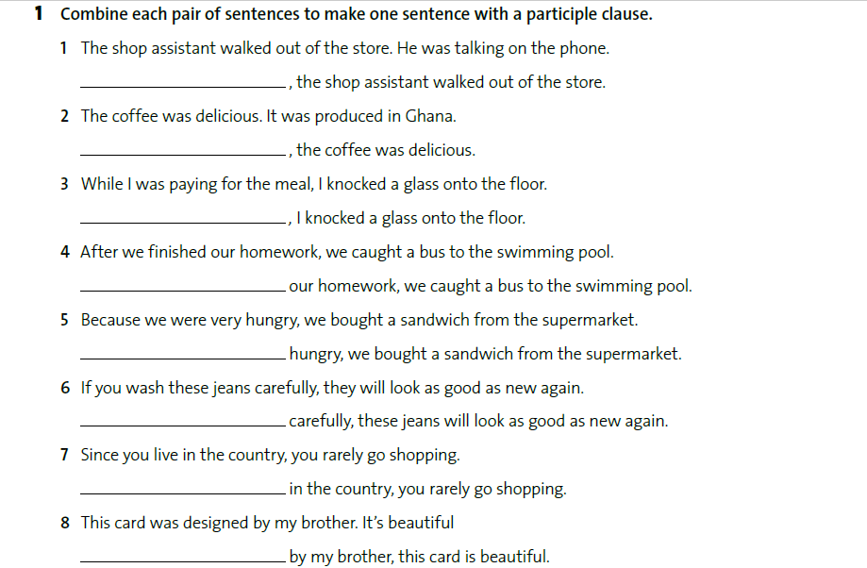
Вопросы. Ответы на следующем слайде

Slide 12
